Slide 1
TITLE
Unique Bio-identification for Home Security on IOT

Slide 2


UNIQUE BIO-IDENTIFICATION FOR HOME SECURITY ON IOT
Prepared by
Mr. VAIBHAV KALE
Mr. ROHIT KASHID
Mr. MEGHAN NAGVEKAR
Mr. BASWARAJ WALKE
Guided by
PROF. G.M. GAIKWAD
Department of Information Technology
Sinhgad Institute of Technology, Lonavala
2017-18

Slide 3
Contents
Abstract
Introduction
Motivation
Objective
Literature Survey
Hardware requirements
Software requirements
Proposed work
System Architecture / Methodology
Algorithm
Power supply
Power supply design
UML Diagrams
Future scope
References

Slide 4
ABSTRACT:
The document explains the importance of access to modern smart homes over the Internet, and highlights several security issues associated with it.
The proposed system illustrates the evolution of the concept of fingerprint device over time. In this work, we propose a two-step verification process for smart homes using a fingerprint device and access credentials of user fingerprint, which verifies the device and the user accessing the home over the Internet.

Slide 5
Introduction
The concept of Home Automation was a topic of interest in the Academic arena since the late 1970s. The affordability and popularity of electronic devices and internet were contributing factors to this change.
Most obvious way to improve security would be to deny access to a home over the internet.
Access should be limited to a fixed number of trusted people using a fixed number of trusted electronic devices. To achieve this, we have to identify the user as well as the device accessing the home over the internet.

Slide 6
Motivation
As we are interested in Embedded Electronics based projects and there are many advantages of the embedded system as well in spite of the electronics based projects.
We are motivated for doing this project because it is a highly secure home automation iot based project and here we get to deal with the Raspberry Pi, its interfacing with the hardware part such as Finger Print Module and PC.

Slide 7
OBJECTIVE:
Successfully identify a device accessing the home over the internet using Device Fingerprinting. Successfully identify a user accessing the home over the internet using his/her fingerprint.
Two-step verification process for smart homes using a fingerprint device and access through user fingerprint
Identify malicious devices and create a blacklist consisting of fingerprints of those devices that will not be allowed access to home. Identify legitimate devices and develop a whitelist consisting of fingerprints of devices that are allowed access to the home.

Slide 8
LITERATURE SURVEY

Slide 9
Sr No | Paper Name | Author Name | System Advantages and Disadvantages
1 | Improving Home Automation Security; Integrating Device Fingerprinting into Smart Home | Arun Cyril Jose1, Reza Malekian1*, Member, IEEE, Ning Ye2, | Advantages: Securing access to a Home over the internet is a vital part in Home Automation Security. Two stage verification process for smart homes, using Device Fingerprints and Login Credentials improve security of home access. Disadvantages: login credential such as passwords are always vulnerable to brute force.

Slide 10
Sr No | Paper Name | Author Name | System Advantages and Disadvantages
2 | A Survey On Improving Home Automation Security by Integrating Device Fingerprinting Into Smart Home | Athira Sankar Lakshmi S | Advantages: This system also provide two step verification with login credential and device fingerprinting. Disadvantages : Security issues associated with username and password.

Slide 11
Sr.No | Paper Name | Author Name | System Advantages and Disadvantages
3 | DEVELOPMENT OF A PROGRAMMABLE ELECTRONIC DIGITAL CODE LOCK SYSTEM | Oke Alice O., Adigun Adebisi A., Falohun Adeleye S., and Alamu F. O. | Advantages: System using password authentication provides considerable security to the users as it acts as a secret of authorized users. Disadvantages: Passwords are always vulnerable to brute force . A study done by K. Kato et al. among 262 University students revealed that, 80% of the passwords were not strong and 40 % of the passwords were reused for different accounts. This concurs with the work of D. Hart who concludes that 30% of people reused their passwords 4 or more times.

Slide 12
Sr.No | Paper Name | Author Name | System Advantages and Disadvantages
2 | AN ADVANCED DOOR LOCK SECURITY SYSTEM USING PALMTOP RECOGNITION SYSTEM | Kawser Wazed Nafi, Tonny Shekha Kar, Sayed Anisul Hoqu | Advantages: Reduces the chances of error in other human recognition methods and clarifies the problems. Disadvantages: 1:High Resolution scanner is needed. 2:Expensive and not user friendly.
3 | DESIGN AND IMPLEMENTATION OF AUTOMATED DOOR ACCESSING SYSTEM WITH FACE RECOGNITIO | I.Yugashini, S.Vidhyasri, K.Gayathri Devi | Advantages: 1: Non intrusive 2:Cheap Technology Disadvantages: 1:These systems have difﬁculty in recognizing a face from images captured from two drastically different views and under different illumination conditions.

Slide 13
HARDWARE REQUIREMENTS
Raspberry Pi
Fingerprint scanner
Laptop/ mobile phone
Relay Circuit
Motor

Slide 14
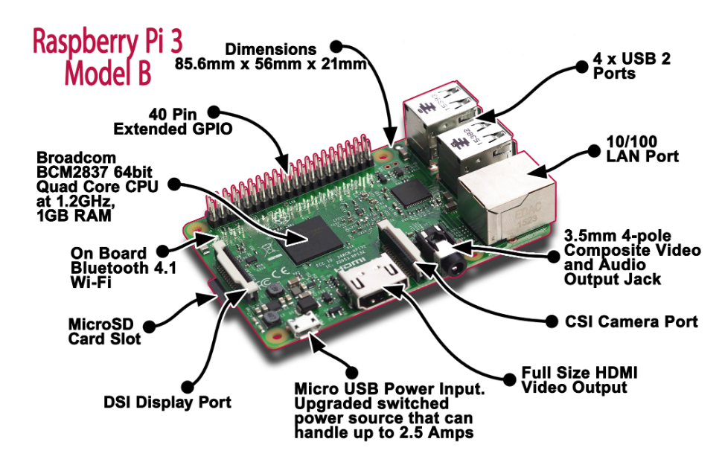
Raspberry Pi 3 Model B

Slide 15
SOFTWARES REQUIREMENTS
Python (Raspberry Pi coding)
PHP
Mysql
Apache Tomcat

Slide 16
Proposed Work
It is clear that there are well documented security issues associated with implementing just password based user authentication in the home automation scenario
Our work utilizes device fingerprinting and user fingerprint as a part of double verification process for authorized user and their device identification.
When a user wishes to access the home over the internet, he requests the page from the server, the server then returns the page for fingerprint request.

Slide 17
The user provides his/her fingerprint along with the fingerprint of the device he/she is using. The login credentials are verified, if the verification is passed, then the further access is allowed.
There are two fingerprint lists in our database, whose entries are accumulated over time.

Slide 18
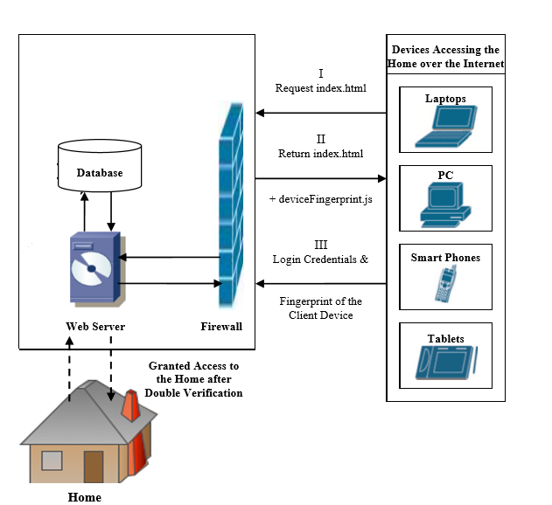
System Architecture
Fig: Architecture of Proposed System

Slide 19
Algorithm
Step 1: Begin
Step 2: Obtain the device fingerprint from the client using javascript.
Step 3: If all of the device fingerprinting parameters are available then step 4 else, step 8.
Step 4: Analyze and compare each device fingerprinting parameter with the fingerprints in the script.

Slide 20
Step 5:If all the parameters match then go to step9 else step 8.
Step 6: Device fingerprint Match found . Do step 9.
Step 7:No device fingerprint match found denied access and go to step 9.
Step 8: Ask user to set parameter according to requirements and go to step2.
Step 9: End .

Slide 21
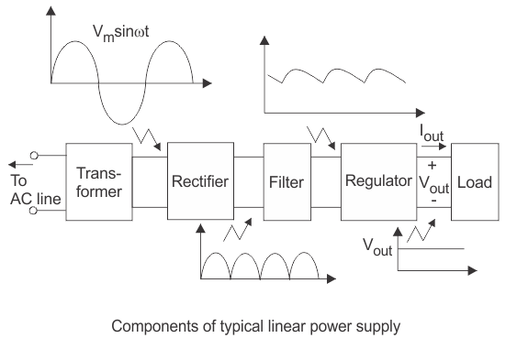
Power Supply

Slide 22
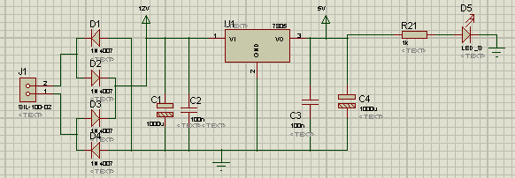
5V Supply Circuit Design

Slide 23
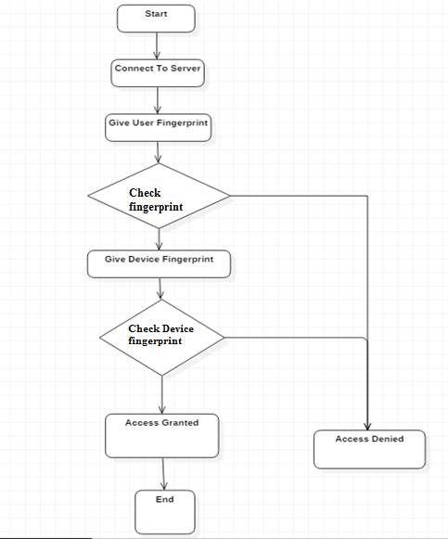
Fig:1 Flow chart of double verification process

Slide 24
DEVICE FINGERPRINTING
-Device Fingerprinting
The user-agent header sent by your browser is:
var x = "User-agent header sent: " + navigator.userAgent;
The result of x will be:
User-agent header sent: Mozilla/5.0 (Windows NT 10.0; Win64; x64)

Slide 25
BROWSER SPECIFIC PARAMETERS USING JAVA SCRIPT
NO | PARAMETER | OBTAINED FROM
1 | Browser Name | navigator.userAgent
2 | Browser Version | navigator.userAgent

Slide 26
DEVICE SPECIFIC PARAMETERS USING JAVA SCRIPT
No | PARAMETER | OBTAINED FROM
1 | OS Name | navigator.userAgent
2 | Device Language
3 | Screen Maximum Width | navigator.screen.maxWidth
4 | Screen Maximum Height | navigator.screen.maxHeight
5 | Time Zone | navigator.date
6 | Country Time | navigator.date
7 | Geographic Location (Latitude,Longitude) | navigator.geolocation. getCurrentPosition()

Slide 27
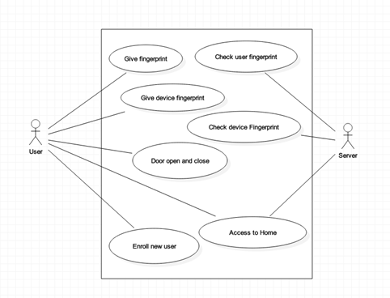
Use Case Diagram

Slide 28
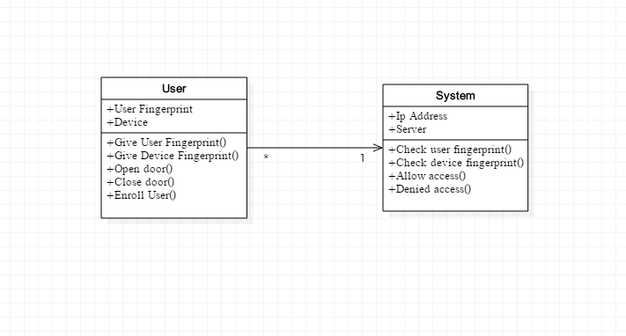
CLASS DIAGRAM

Slide 29
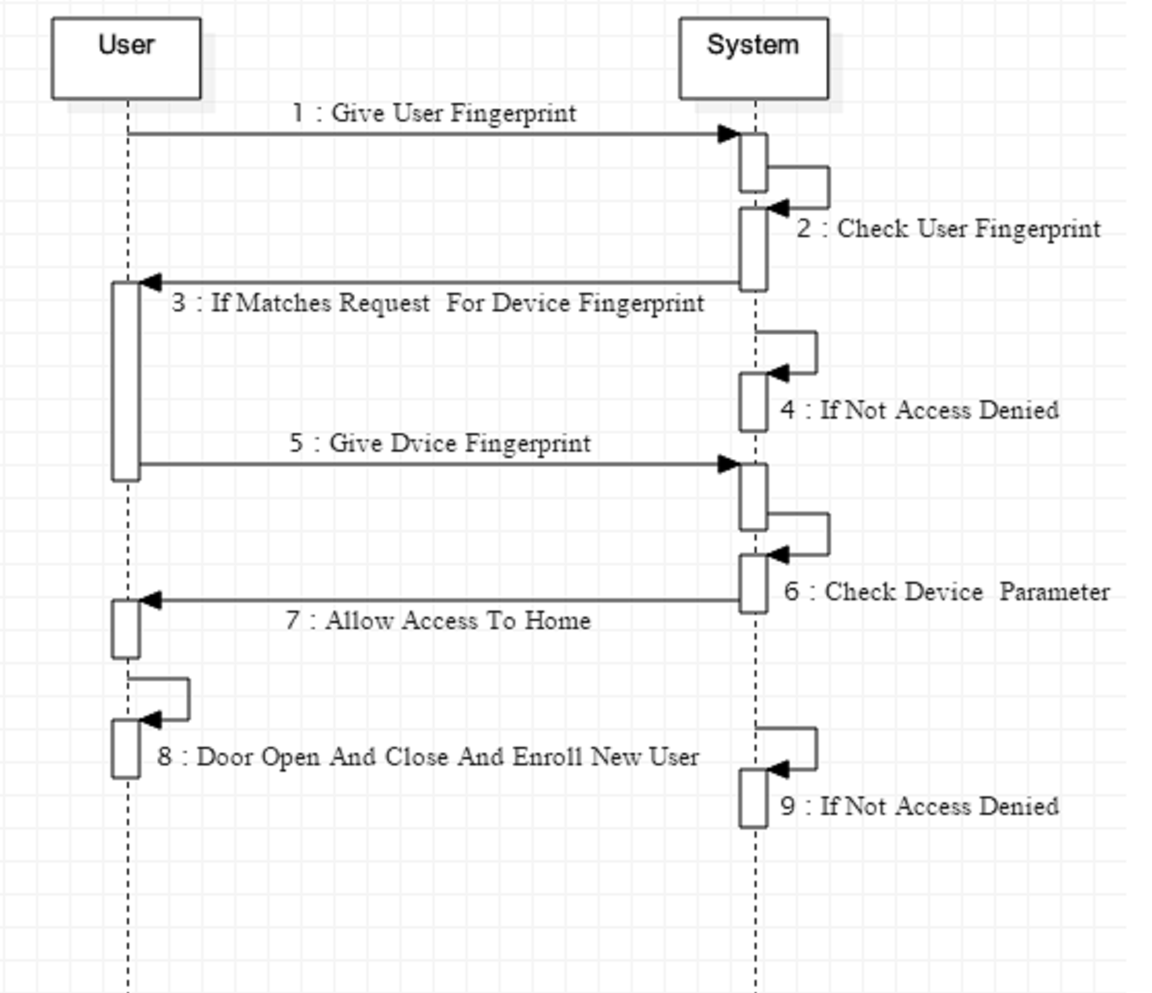
Sequence Diagram

Slide 30
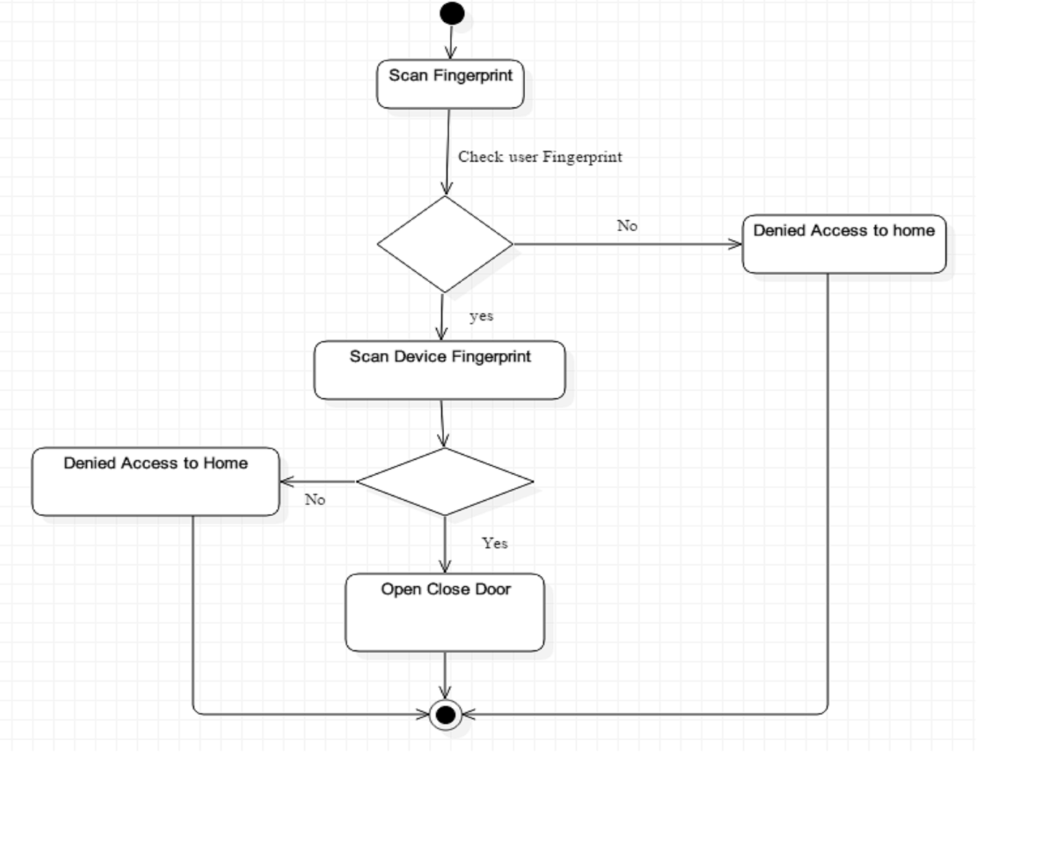
ACTIVITY DIAGRAM

Slide 31
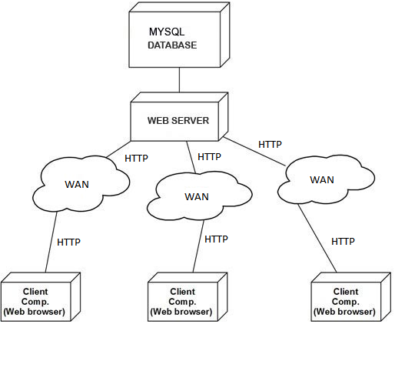
DEPLOYMENT DIAGRAM

Slide 32
FUTURE SCOPE
Device Fingerprint can be further extend to whitelist and blacklist, where the client should be verified by some other more direct method in order to assure legitimacy. A simple and safe method would be make contact with the client using a phone call to the registered mobile number of the client and verify it is him trying to login to his home.
Another alternative is, the server generates a One Time Password (OTP) and sent it to the legitimate user‘s registered mobile number via Short Message Service (SMS), which the user enters in the website and thus the legitimacy of the user is verified.

Slide 33
REFERENCES
1]Arun Cyril Jose, Reza Malekian, “Improving Home Automation Security; Integrating Device Fingerprinting into Smart Home”,DOI 10.1109/ACCESS.2016.2606478, IEEE Access.
2]AthiraSankar, Lakshmi S, “A Survey On Improving Home Automation Security by Integrating Device Fingerprinting Into Smart Home”, International Research Journal of Engineering and Technology (IRJET) ,Volume: 04 Issue: 04 | Apr -2017.
3] Murad Khan, BhagyaNathali Silva, Kijun Han“Internet of Things based Energy Aware Smart Home Control System”,DOI 10.1109/ACCESS.2016.2621752, IEEE Access.
4]Jayasree Baidya, Trina Saha, Ryad Moyashir, Rajesh Palit, “Design and Implementation of a Fingerprint Based Lock System for Shared Access”, North South University, Dhaka - 1229 {jayasree.baidya, trina.saha, ryad.moyashir.
5] Shrikrishna Jogdand1, Mahesh Karanjkar, “Implementation of Automated Door Accessing System with Face Design and Recognition” , International Journal of Science and Research (IJSR) ISSN (Online): 2319-7064 Index Copernicus Value (2013): 6.14 | Impact Factor (2014): 5.611

